Slide 1
INDEX
1. Types of brakes
2. Safety systems to improve braking performance &prevent accidents

Slide 2
1.Types of brakes
Drum Brakes,
Disc Brakes,
Rim brakes
Regenerative Brakes

Slide 3
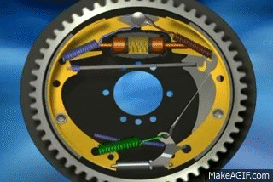
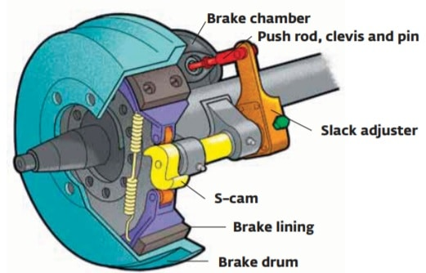
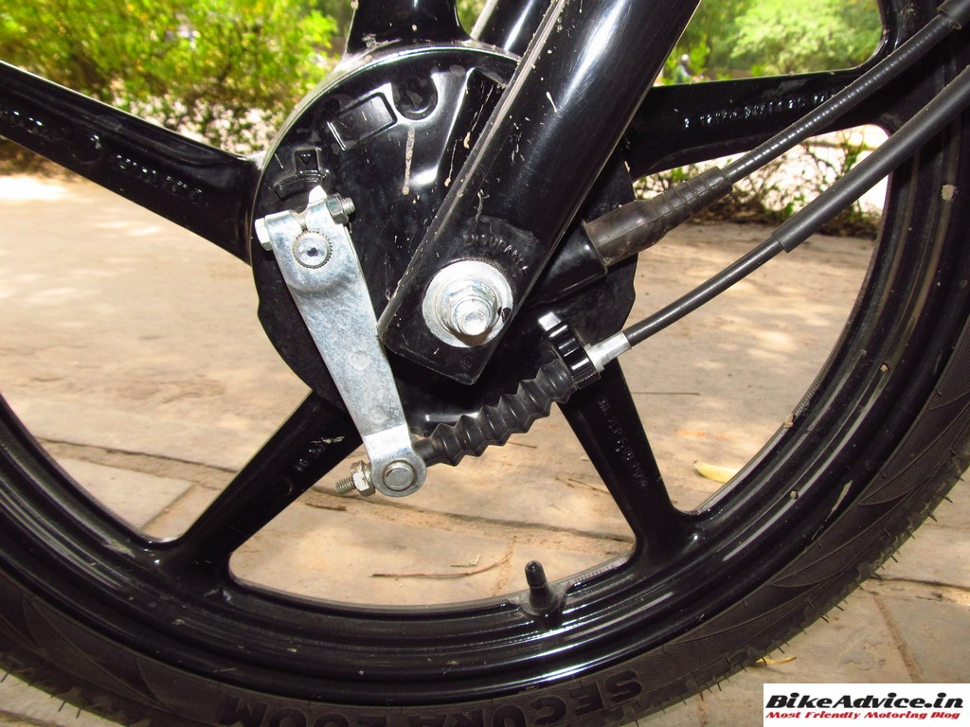
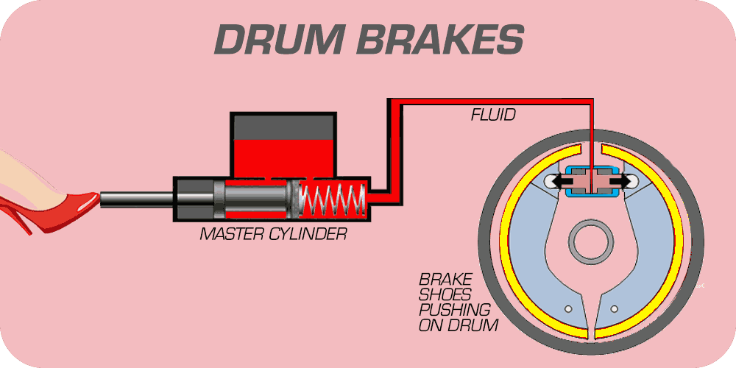
1.Drum Brakes
A cylindrical drum rotates with the wheel, with brake shoes inside that press against its inner surface.
Mechanically operated
drum brakes
Hydraulically operated
drum brakes
Air pressured operated
Drum brakes

Slide 4
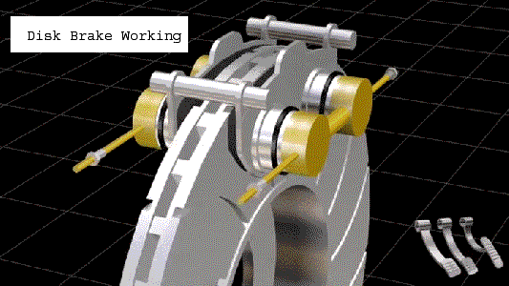
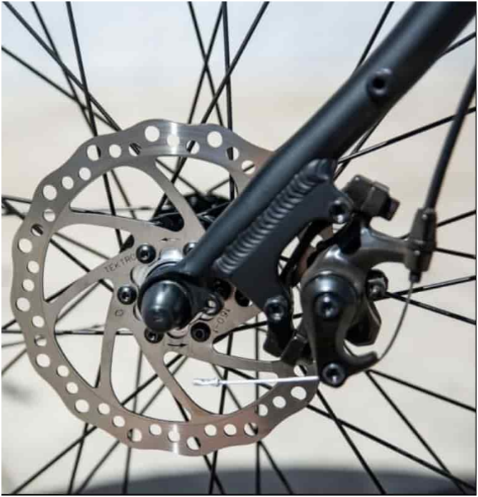
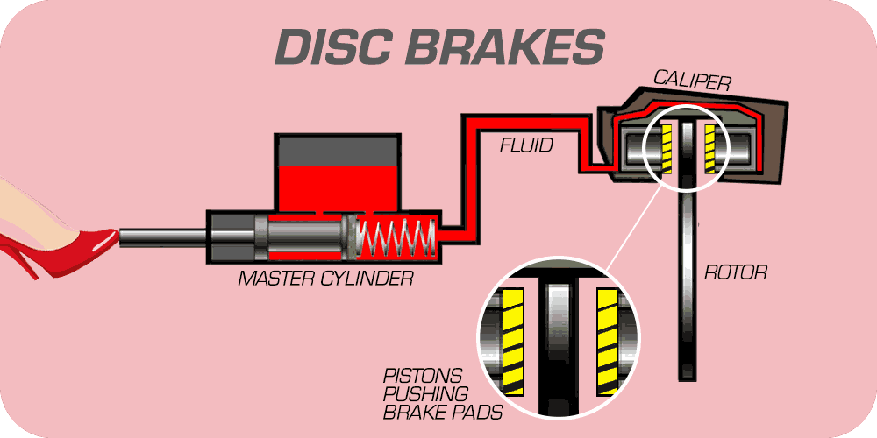
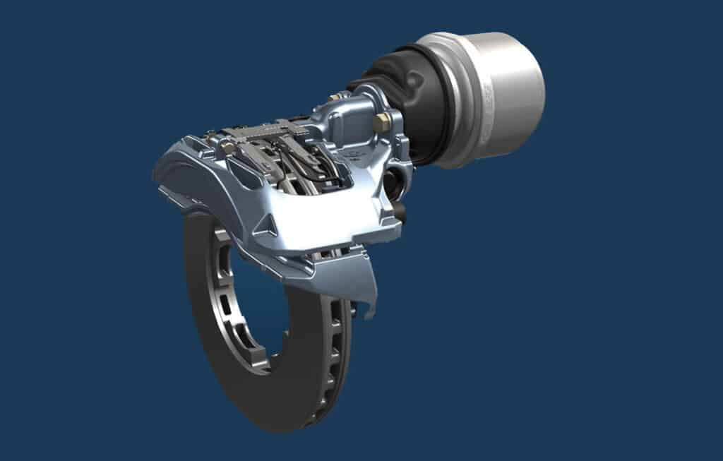
2.Disc Brakes
A flat disc (rotor) attached to the wheel is squeezed by brake pads on either side.
Mechanically operated
disc brakes
Air pressured operated
Disc brakes
Hydraulically operated
disc brakes

Slide 5
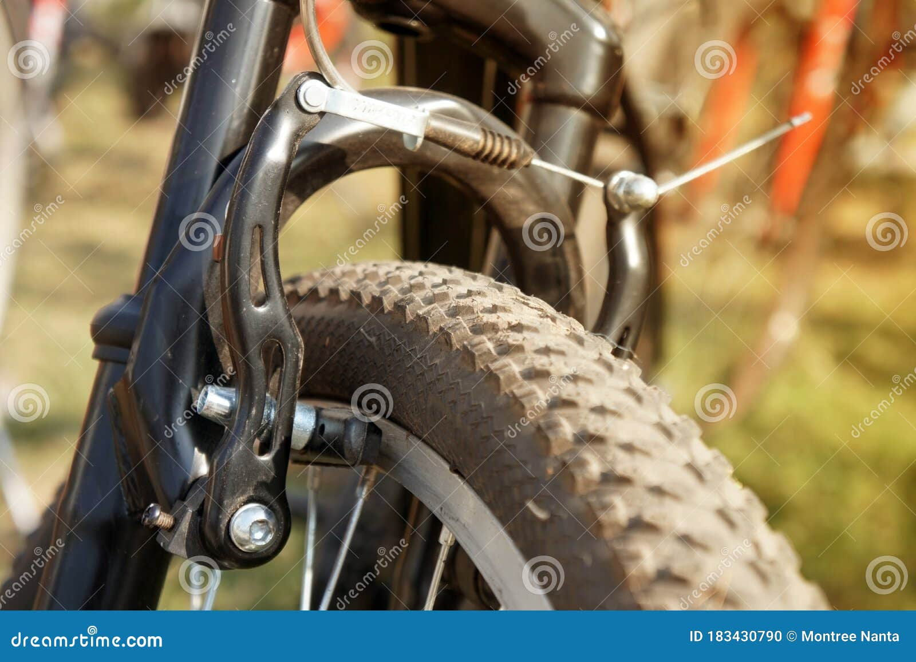
3. Rim brakes
are categorized under friction brakes
Brake pads press against the wheel rim to create friction

Slide 6
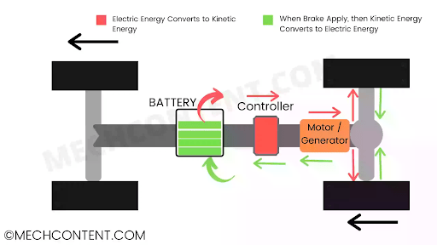
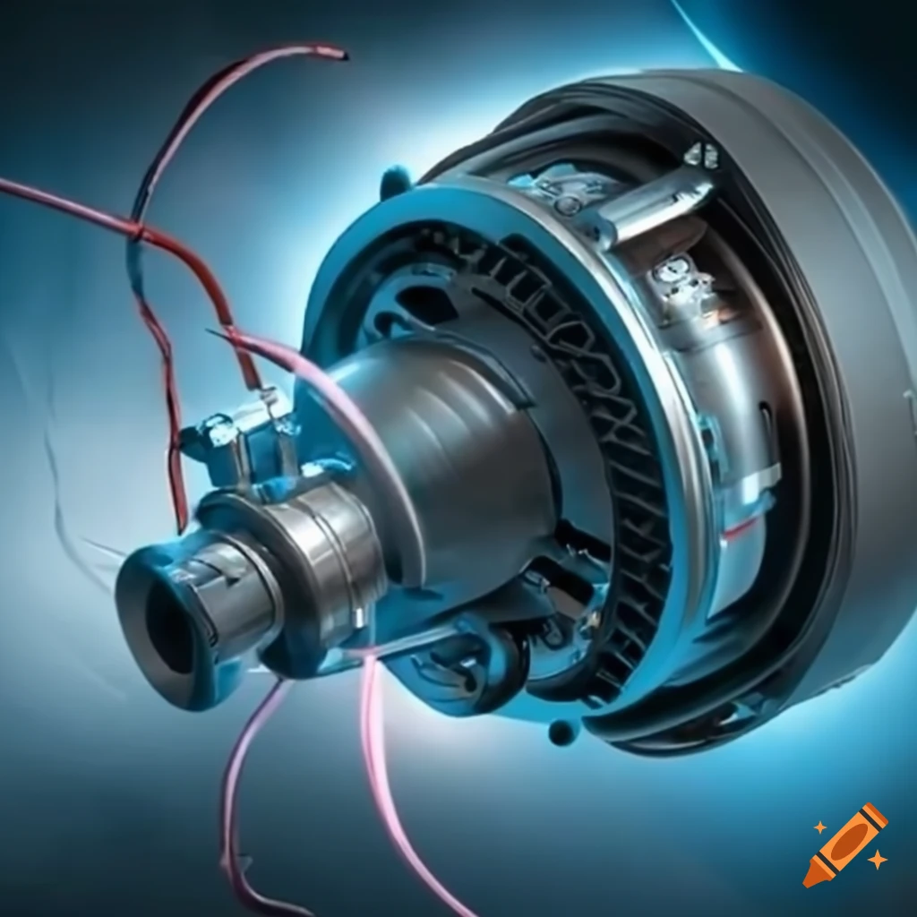
4. Regenerative braking
Energy Recovery: Converts kinetic energy from braking into electrical energy using the electric motor as a generator.
Efficiency: Stores the generated energy in the battery, improving overall energy efficiency while often workingalongside conventional brakes.

Slide 7
2. safety systems or technologies designed to improve braking performance &
prevent accidents
Anti-lock Braking System (ABS):
It's a technology that prevents the wheels from locking up during hard braking,
allowing the driver to maintain control of the vehicle.
It works with existing brake types (like disc or drum brakes) to improve safety, especially during emergency stops.
Collision Mitigation Brakes:
This is part of an advanced driver-assistance system that detects potential collisions and automatically applies the brakes to either avoid or reduce the severity of an impact.
It works with the existing brake system, not a type of brake itself.

Slide 8
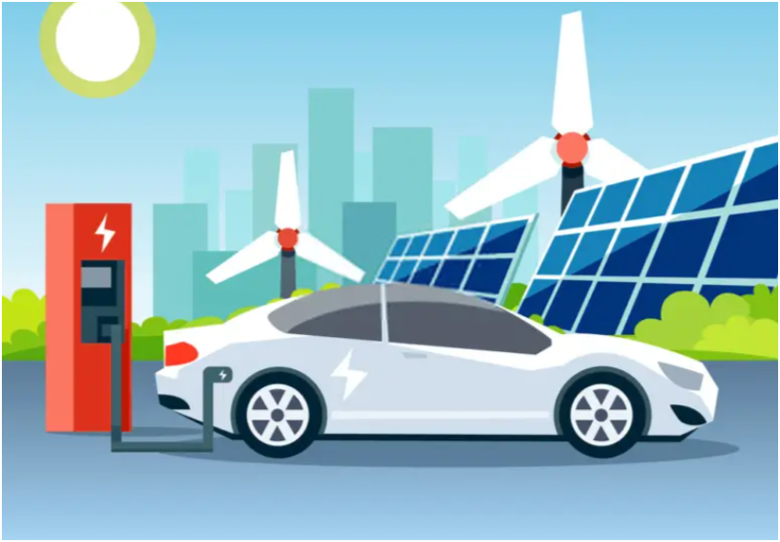
Thank You !!
"Drive the future with innovation—join us in building a game-changing electric carrier that combines cutting-edge features with unbeatable affordability!"

